Slide 1
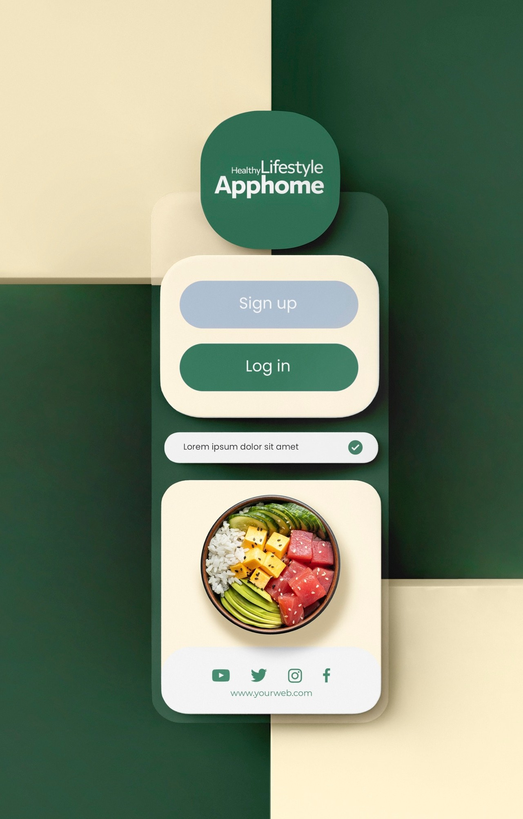
Revolutionizing Student Dining: Bhojanalya - A Game-Changing Meal Booking
Platform for Students and PG Residents

Slide 2
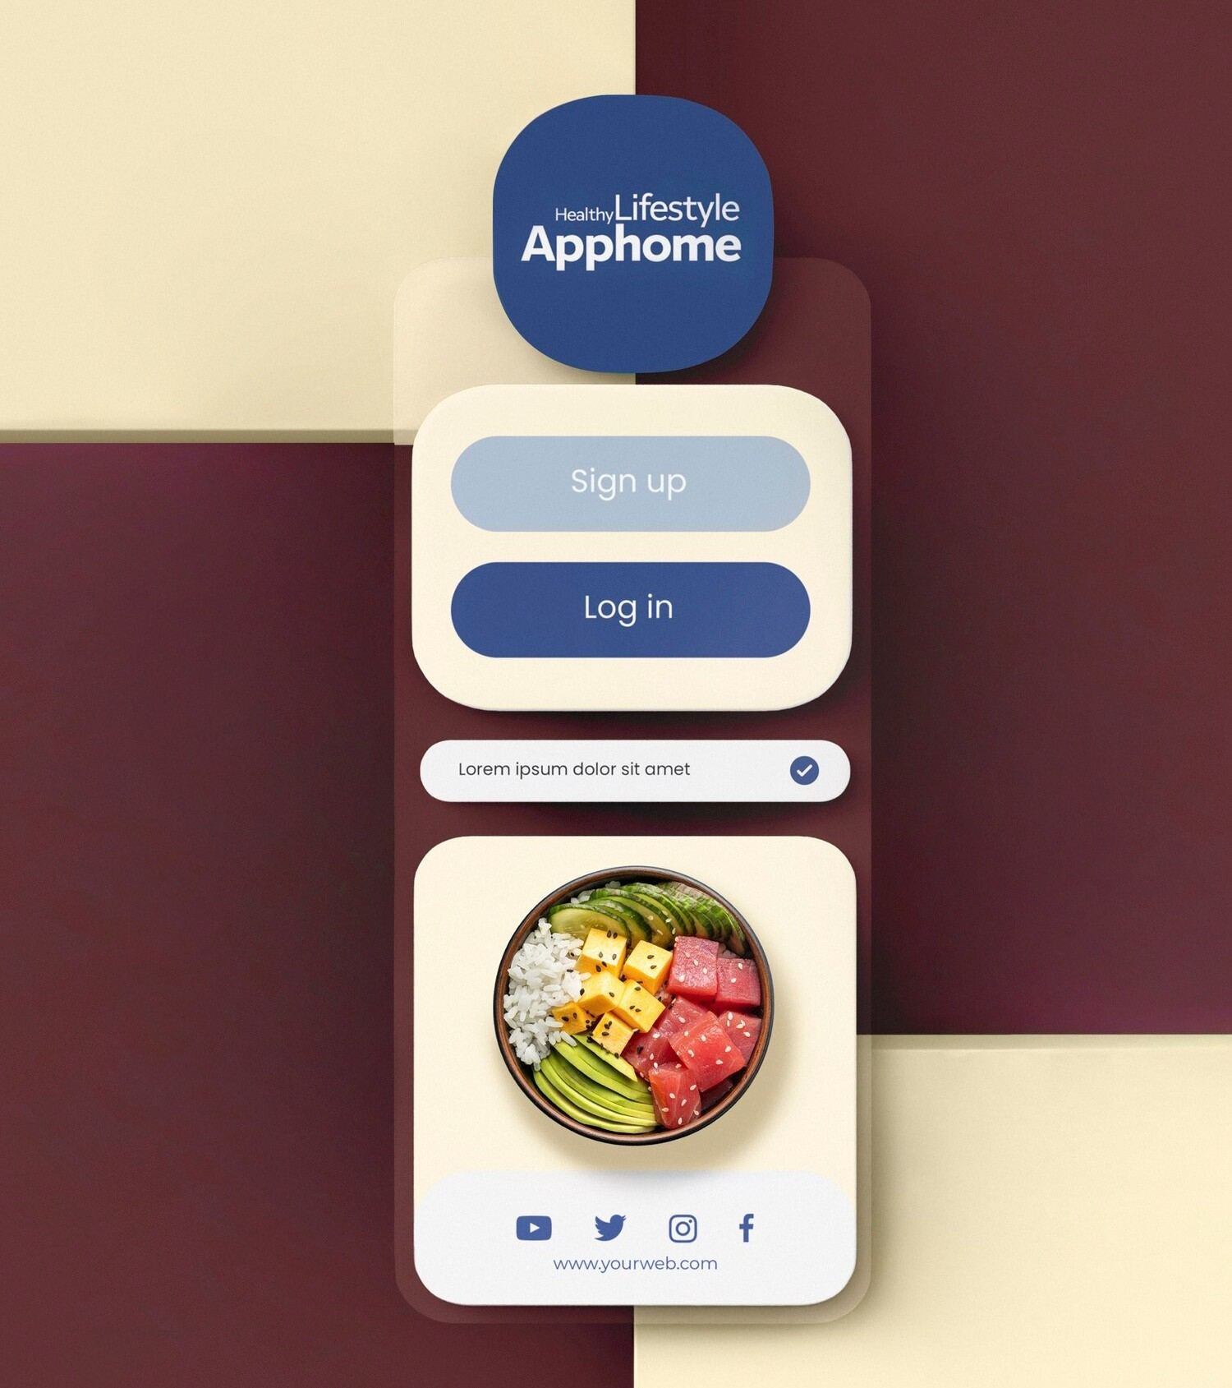
Introduction
Welcome to the presentation on
Bhojanalya - a revolutionary
designed to cater to
the needs of students and PG residents. This platform aims to streamline the dining experience and provide a convenient solution for meal
management.

Slide 3
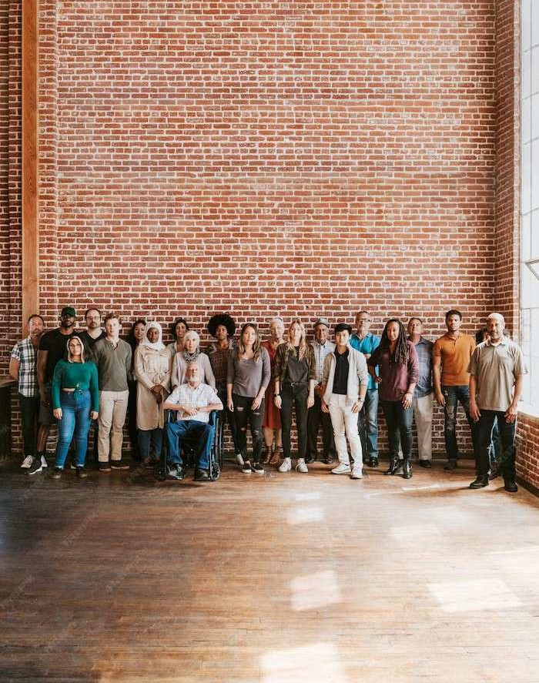
Challenges Faced
Students and PG residents often encounter and limited meal options in dining
facilities. Additionally, managing meal plans and
tracking expenses can be a
Bhojanalya addresses these challenges with innovative solutions.
.

Slide 4
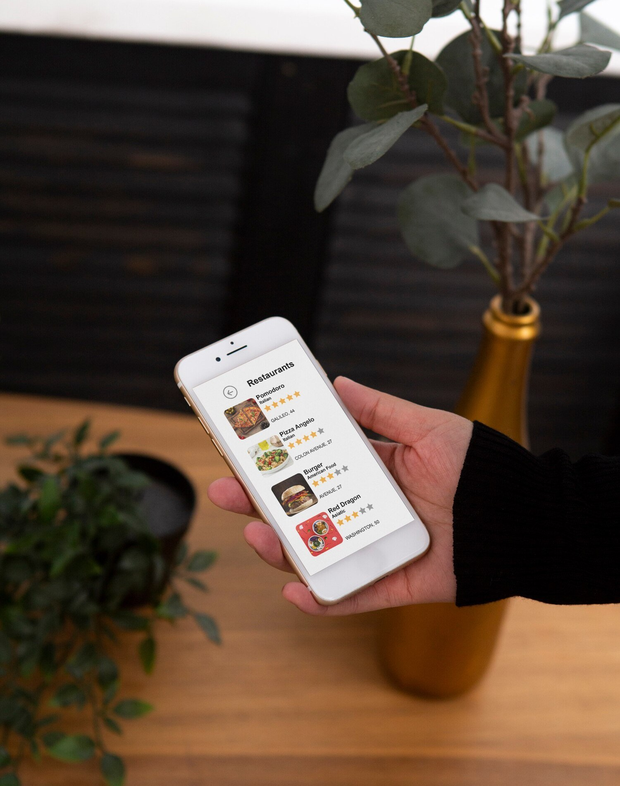
Key Features
Bhojanalya offers advanced slot booking to help you plan your meals. With this feature, you can book your meals in advance and choose from a variety of cuisine options. The platform also provides a seamless payment system and personalized recommendations based on your preferences.

Slide 5


Beneﬁts for Users
Bhojanalya enhances the dining experience by offering
, reducing waiting time, and ensuring access to a diverse range of
. Users can also enjoy
, making
dining more affordable.

Slide 6

Market Potential
The student dining market presents a significant opportunity for Bhojanalya to thrive. With a growing number of students and PG residents seeking
, the platform is well-positioned to capture a
substantial market share.

Slide 7
Conclusion
In conclusion, Bhojanalya is poised to revolutionize the student dining experience by offering a
. With its user-friendly interface and array of features, the platform is set to become the go-to choice for students and PG residents seeking a hassle-free
dining experience.

Slide 8
Thanks!

